Slide 1
COVID-19 CASES IN ILLINOIS
By Milana Walden & Elena Pérez-Ródenas Martínez

Slide 2
Index
Status of COVID-19 in Illinois
Data, basic statistics of data analysis, data exploration
Basic infection rate with linear data fitting
Discrete-Time Dynamical System models for disease dynamics
Results
Conclusion

Slide 3
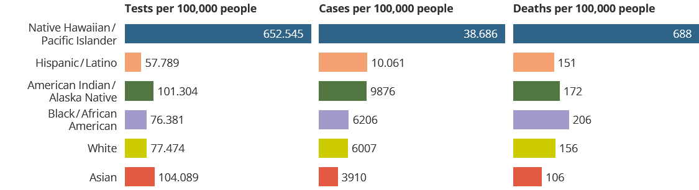
Covid cases by ethnicity in Illinois
https://covidtracking.com/data/state/illinois/race-ethnicity

Slide 4
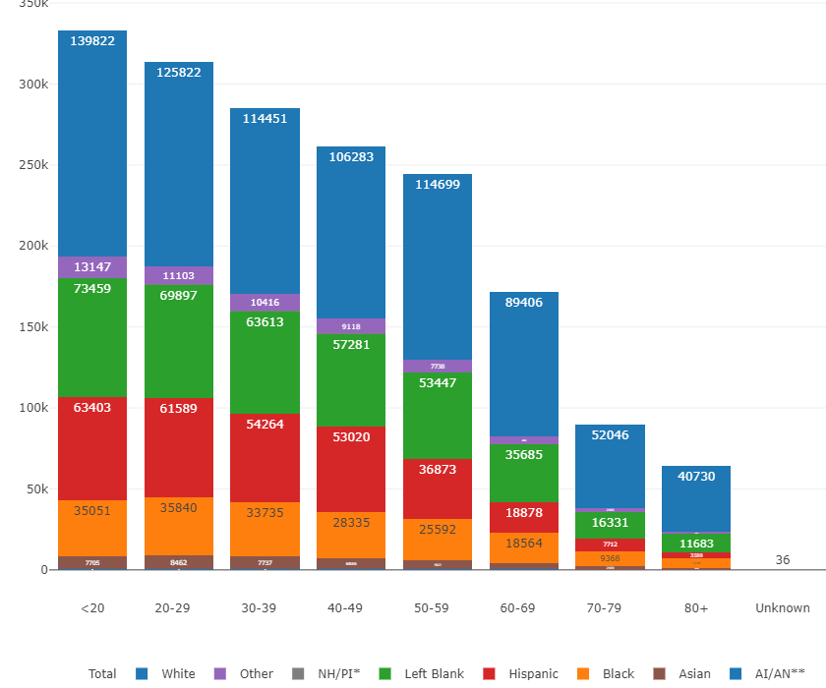
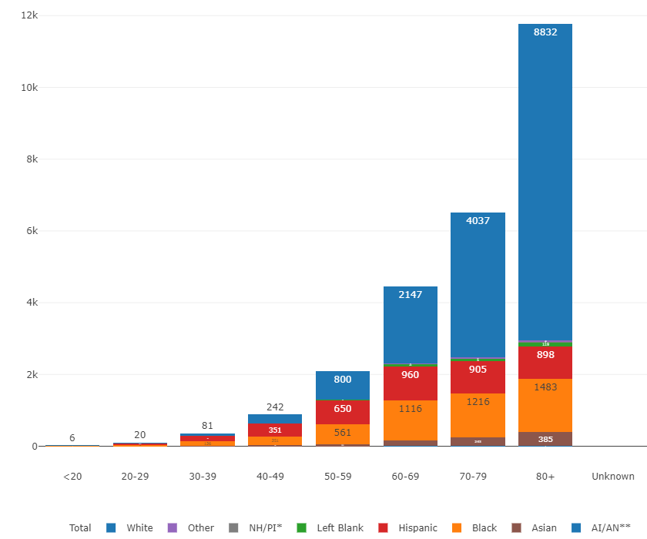
Age Demographics
Cases
Deaths
Notes:
Illinois Data

Slide 5
2. Basic statistics
For COVID cases
Median = Middle value of your observations when they are ordered by smallest to largest
3910, 6007, 6206, 9876, 10061, 38686 => (6206+9876)/2=8041
Mean = (3910+6007+6206+9876+10061+38686 )/6=74746/6=12457.67
Mode = Most common outcome = all of them are modes because there are no repetitions
Range = 38686-3910 = 34776
Q1 = 6007, Q3 = 10061, IQR = Q3-Q1 = 10061-6007 = 4054
Variance =
Standard deviation =

Slide 6
For COVID tests
For COVID deaths
57789, 76381, 77474, 101304, 104089, 652646
106, 151, 156, 172, 206, 688
Median = 89389
Mean = 161393.17
Mode = all of them are modes
Range = 594857
Q1 = 76381, Q3 = 104089, IQR = 27708
Variance = 4.55*10^10
Standard Deviation = 213396.0088
Median = 164
Mean = 246.5
Mode = all of them are modes
Range = 582
Q1 = 151, Q3 = 206, IQR = 55
Variance = 39860.58
Standard Deviation = 199.6511

Slide 7
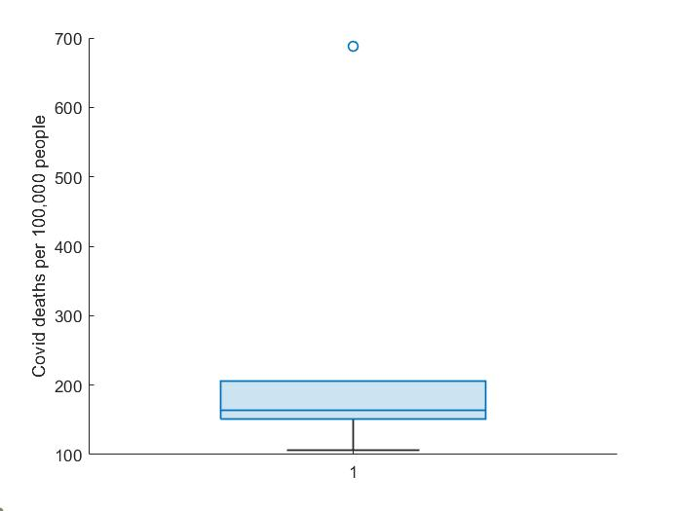
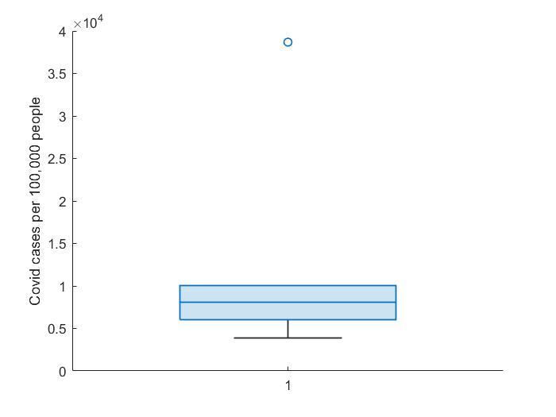
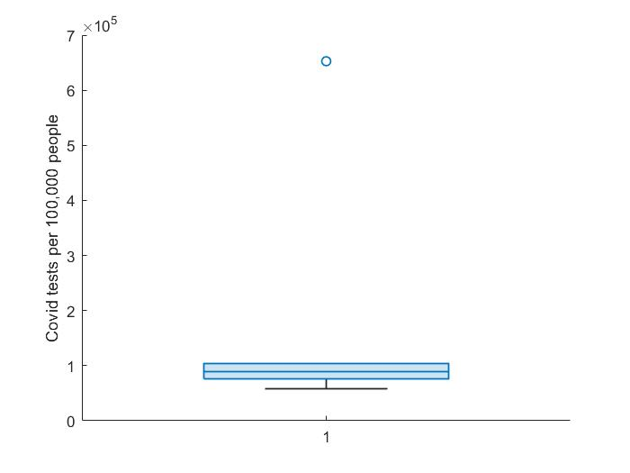
Boxplots for COVID tests, cases and deaths

Slide 8
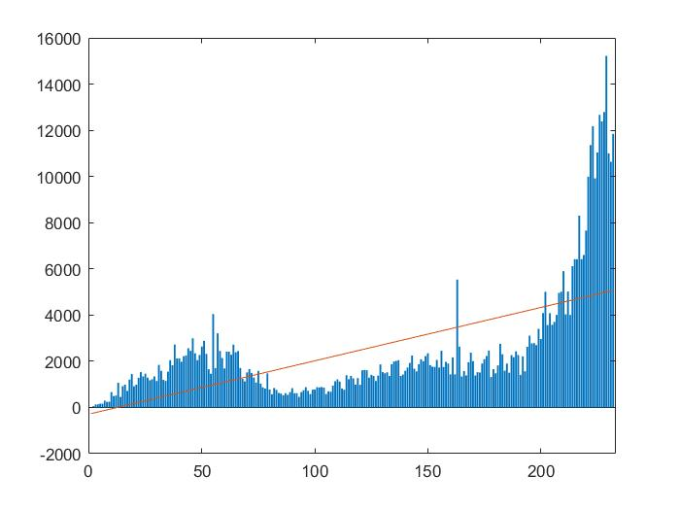
Basic infection rate with linear data fitting
Covid cases from 16 march 2020 to 16 november 2020.
Sxy = -1.1659e+09
Sxx = -5.6687e+07
Linear model: y = 20.57 x+5.30 so the infection rate beta=20.57
https://www.nytimes.com/interactive/2021/us/illinois-covid-cases.html

Slide 9
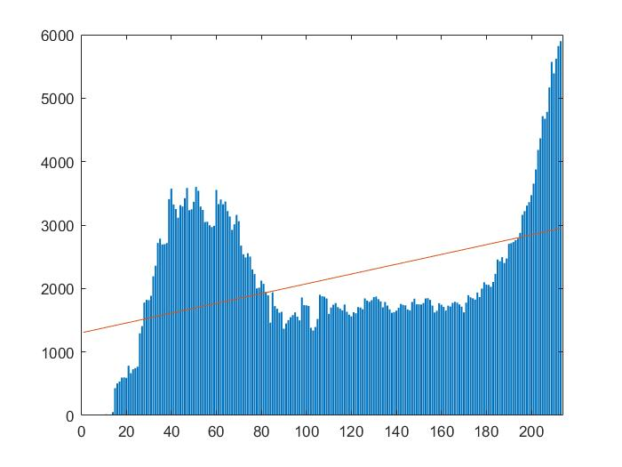
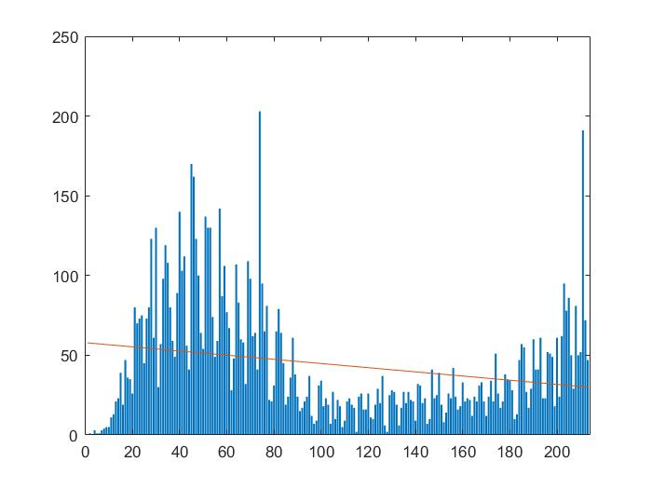
Rate of hospitalization
Rate of death
Linear Model: y = -0.13 x+57.90
Rate of death: beta=-0.13
Linear Model: y = 7.72 x+1302.10
Rate of hospitalization: beta=7.72

Slide 10
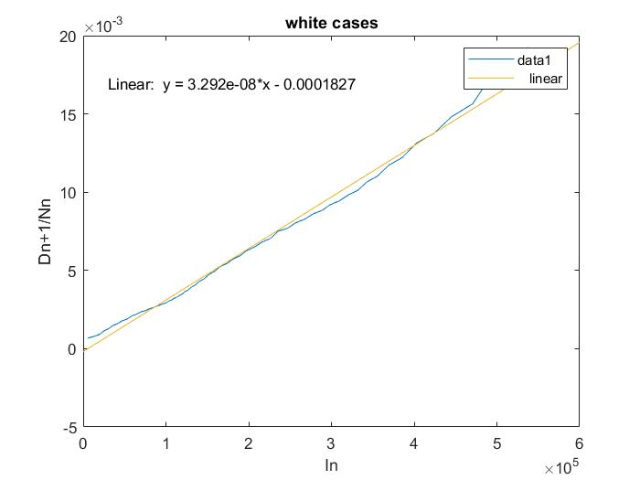
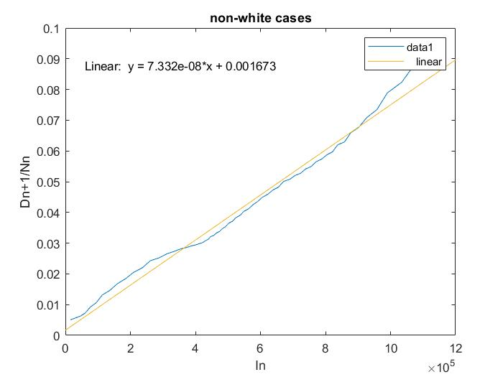
Discrete-Time Dynamical System models for disease dynamics
We consider two groups: White people and not-white people.
We collect the COVID cases from 16 april to 16 november of each group every 3.5 days so gamma = 1/4
We construct the graph and get the slope of each group. 3.292e-8 and 7.332e-8 respectively
https://covidtracking.com/data/state/illinois/race-ethnicity/historical

Slide 11
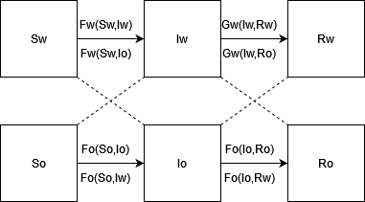
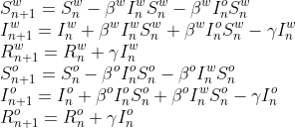
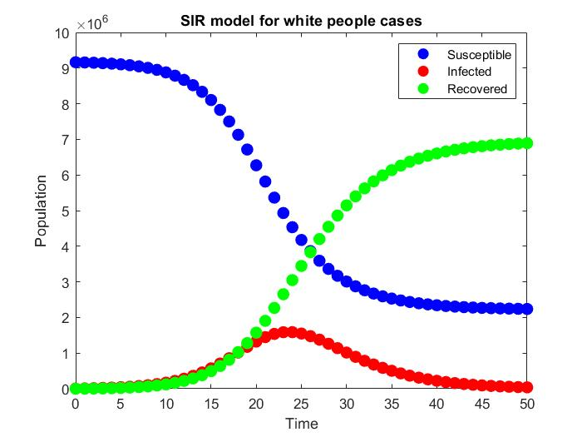
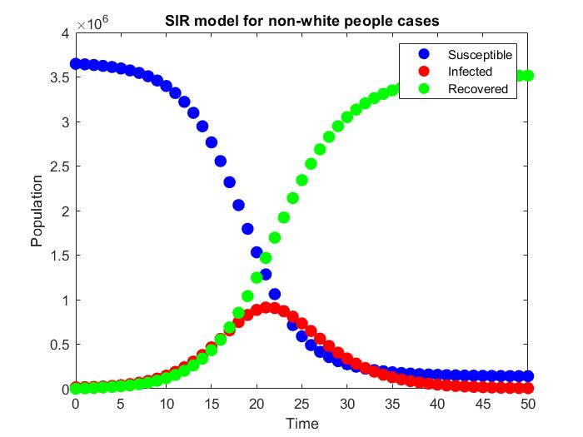
SIR Model

Slide 12
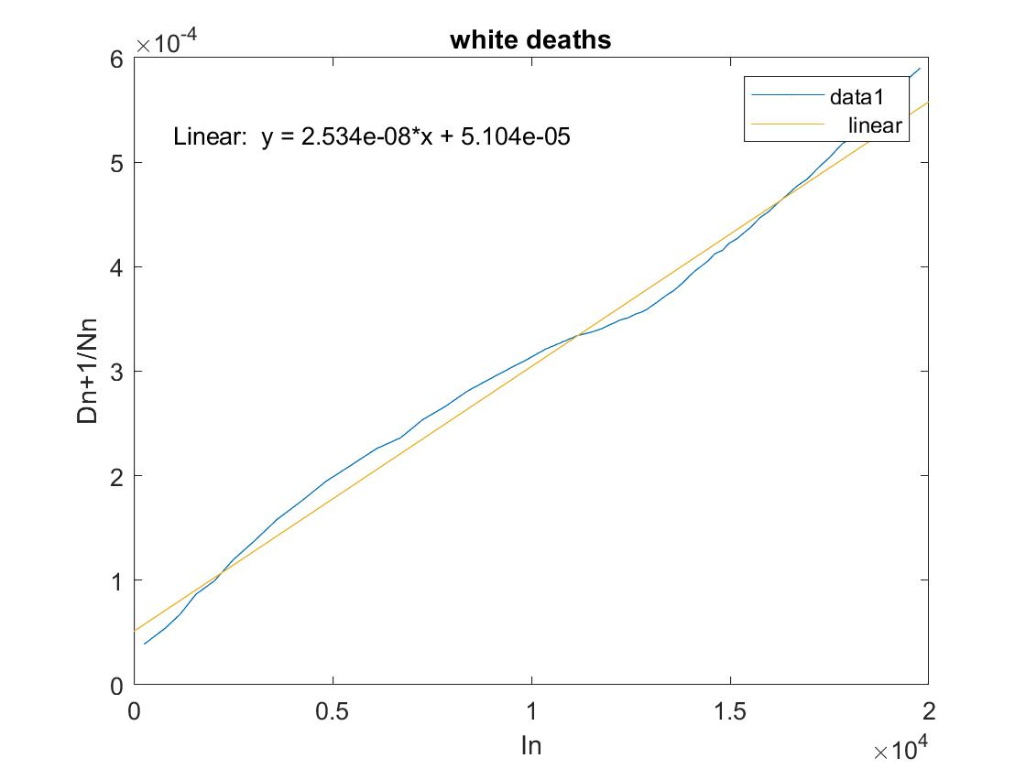
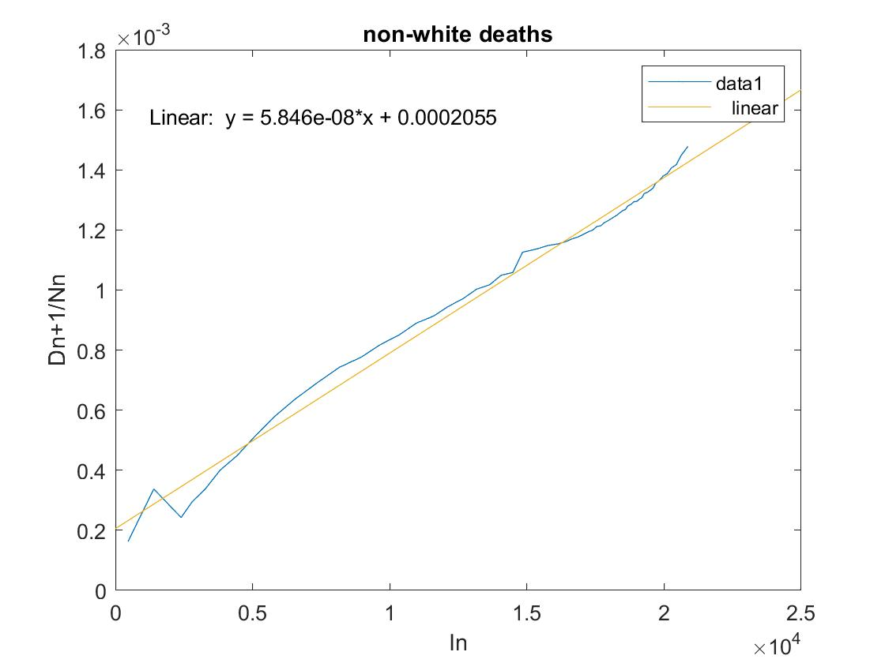
Results - total deaths
*Illinois does not report rate/ethnicity data for hospitalizations

Slide 13
Conclusion:
Covid peak in Illinois: June 2020
Infection rate -> close to zero
Higher rise in cases and deaths within the non white population
Higher infection rate within the non-white population

